Slide 1
HDD,SSD AND SSHD
ESHAL KHAN
BS AI (1ST)

Slide 2
WHAT IS A HARD DISK DRIVE (HDD)?
A hard disk drive (HDD) is a storage device that uses magnetic storage to store and retrieve digital information using one or more rigid rapidly rotating disks(platters)coated with magnetic material
The platters are paired with magnetic heads,usually arranged on moving actuator arm,which read and write data to the platter surfaces.
Data is accessed in a random access manner,meaning that individual blocks of data can be stored or retrieved in any order and not only sequentially.

Slide 3
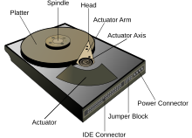
HOW IT WORKS?
Data is written to magnetic disks using read/write heads.
Disks spin at high speed (typically 5400-7200 RPM).
Read/write heads above disks,reading/writing data.
Data is stored in tracks,sectors and clusters.

Slide 4
TYPES OF HDD
HARD DISK DRIVE
internal
HDD
External
HDD
Desktop
HDD
Laptop
HDD
Hybrid
HDD

Slide 5
WHAT IS SOLID STATE DRIVE(SSD)?
A solid state state drive(SSD)is a data storage device,typically used in a computer .It uses flash memory to store data even after power is turned off.SSDs are designed to access data in the same way as traditional hard disk drives.
SSDs have no moving mechanical components.This distinguishes them from traditional electromechanical drives such as hard disk drives or floppy disks,which contain spinning disks and movable read/write heads.
Compared with electromechanical drives,SSDs are typically more resistant to physical shock ,run silently,have quicker access time and lower latency.

Slide 6
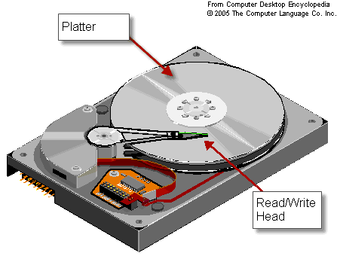
HOW IT WORKS?
Data is written to flash memory chips.
Controller chip manages data storage and retrivel.
Interface connects SSD to computer.
Cache memory(If present)optimizes performance.

Slide 7
TYPES OF SSD
SOLID STATE DRIVE
SATA
SSD
PCLe
SSD
NVME
SSD
M.2
SSD
U.2
SSD

Slide 8
DIFFERENCES BETWEEN SSD AND HDD
DIFFERENCES SPEED Capacity and associated costs. Nature of operations Power consumption Heat | HDD Slower read/write speeds Higher capacity,lower cost per GB. Mechanical movement. Consumes more power,can reduce battery life. Moving parts generate more heat ,potentially causing damage. | SDD Faster read/write speeds Smaller capacity,higher cost per GB. No mechanical movement. Consumes less power,extends battery life. Generates less heat ,contributing to its lifespan.

Slide 9
WHAT IS SOLID STATE HYBRID DRIVE(SSHD)?
SSD is a storage device that combines a traditional hard disk drive(HDD) with a solid state drive(SSD) cache,providing a balance between storage capacity,performance and cost.
Using a small SSD cache to store frequently accessed data,such as operating system files,applications and user data.
Storing less frequently accessed data on the larger HDD.
Automatically optimizing data placement between SSD and HDD.

Slide 10
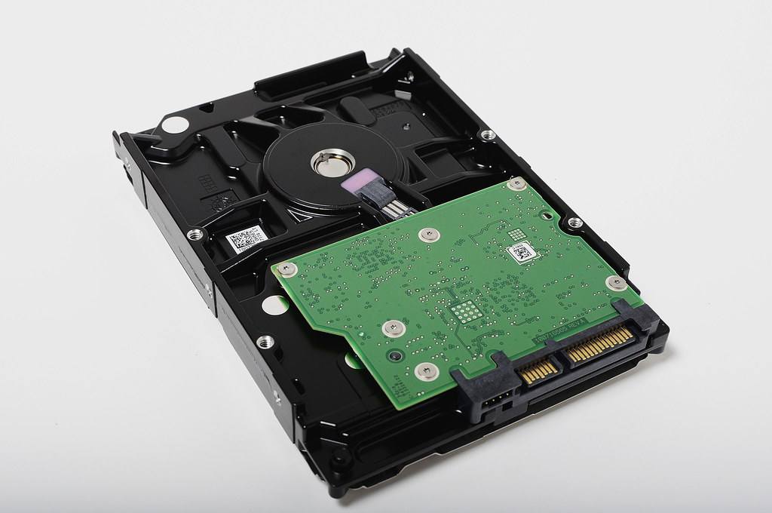
HOW IT WORKS?
Initial data access : SSHD retrives data from HDD.
Frequently accessed data : SSHD caches data in SSD.
Subsequent access : SSHD retrives data from SSD cache.
Maintenance : cache cleaning(removing unused data),cache optimization(reorganizing data).

Slide 11
TYPES OF SSHD
BASED ON ARCHITECTURE
Single tier
SSHD
Dual tier
SSHD
Multi tier
SSHD

Slide 12
THANK YOU FOR YOUR ATTENTION

